Slide 1
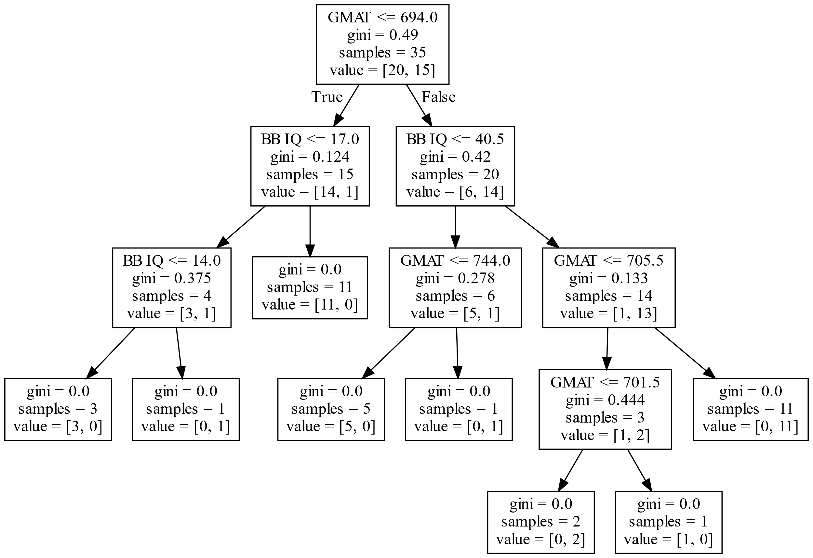
Sci-Kit-Learn Decision Tree
UNC vs. Duke MBA Choice
Will awfully overfit without controlling hyperparameters or using cross-validation. This dataset is not large enough

Slide 2
Sci-Kit-Learn Logistic Regression
UNC vs. Duke MBA Choice
L2-Regularized
No Penalty (EXCEL)
Coefficient Value
-------------------- --------
Intercept : -58.8009
GMAT : 0.0781
Private University : 0.5581
BB IQ : 0.0629
Coefficient Value
-------------------- --------
Intercept : -70.1946
GMAT : 0.0937
Private University : 1.6816
BB IQ : 0.0618
Confusion Matrix
Actual
UNC Duke
Predicted UNC 18 2
Duke 1 14
Confusion Matrix
Actual
UNC Duke
Predicted UNC 18 2
Duke 2 13

